Slide 1

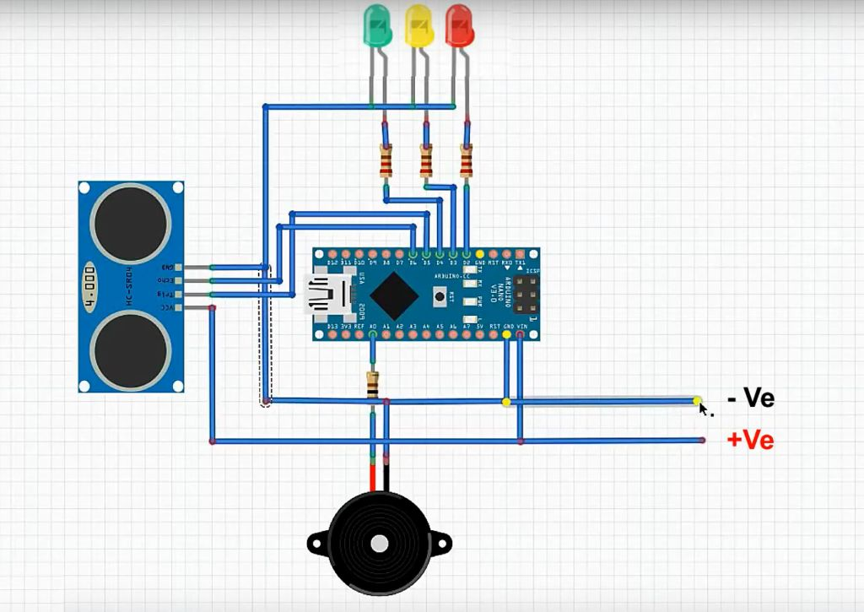
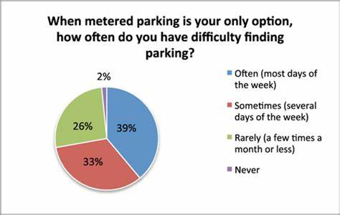
Smart car parking sensor system using iot
Student Name (Reg. No.) Sai Rashwant VS(20BCE1332), Ashwin Sivasankar V(20BCE1804)
Guide: Dr. Illavarasi
School of Computer Science And Engineering
INDUSTRY CONCLAVE 2023
INTRODUCTION
Due to the proliferation in the number of vehicles in the parking , car parking issues are bound to exist. This is due to the fact that the current transportation infrastructure and car parking facility developed are unable to cope with the influx of vehicles on the road.To alleviate the aforementioned problems, the smart parking system has been developed. With the implementation of the smart parking system, you can comfortably park your car.
1.Following the rapid incense of car ownership, many cities are suffering from lacking of car parking areas with imbalance between parking supply and demand which can be considered the initial reason for metropolis parking problems.
2. Shortage of parking space, high parking tariffs, and traffic congestion due to visitors in search for a parking place are only a few examples of everyday parking problems.
Objectives
The main objective of a car parking sensor system using Arduino is to assist drivers in maneuvering their vehicle into a parking spot safely and accurately, while avoiding collisions with obstacles such as walls or other vehicles.
The system uses ultrasonic sensors to detect the distance between the vehicle and nearby objects, and
provides feedback to the driver through visual and/or audible alerts. The Arduino microcontroller processes the sensor data and controls the feedback mechanisms, allowing for real-time monitoring and guidance during the parking process.
Ultimately, the goal is to improve safety and reduce the risk of accidents in parking lots and other confined spaces.
SCOPE of the project
The scope of a car parking sensor system using Arduino is quite broad, as it has the potential to enhance the safety and convenience of drivers by helping them to park their vehicles more easily and avoid collisions with obstacles or other vehicles.
Enhanced safety
Improved convenience:.
Cost-effectiveCustomizable: With the flexibility and versatility of the Arduino platform, it is possible to customize the parking sensor system to suit specific needs or preferences
methodology
Gather materials: Arduino board, ultrasonic sensors, wires, breadboard, and power supply.
Connect the ultrasonic sensors to the Arduino board according to the manufacturer's specifications.
Set up the Arduino software on your computer and open a new sketch.
Write the code to detect the distance between the car and the obstacle, based on the readings from the ultrasonic sensors.
Upload the code to the Arduino board.
Test the system by placing the ultrasonic sensors at various distances from the obstacle and observing the output.
Make any necessary adjustments to the system and code to optimize its performance.
Architecture
In this architecture, ultrasonic sensors are used to detect the distance between the car and obstacles, and the readings are sent to an Arduino board. The board processes the data and sends output signals to a display and a buzzer to alert the driver of the distance and proximity of the obstacle.
Ultrasonic Sensors: These sensors are used to measure the distance between the car and the object behind it. They work by emitting sound waves and then measuring the time it takes for the waves to bounce back. Based on the time taken, the distance between the car and the object can be calculated.
Arduino Board: The Arduino board is used to process the data from the ultrasonic sensors and send signals to the buzzer. The board receives the distance measurements from the sensors, processes the data using a programming language such as C++, and then sends a signal to the buzzer when the distance is low.
Buzzer: The buzzer is used to alert the driver when the car is too close to the object behind it. It produces a loud, audible sound that is easily noticeable by the driver.
Results and discussion
the results of a car parking sensor system using arduino will depend on the implementation and calibration of the system. if properly designed and configured, a car parking sensor system using arduino can provide accurate and reliable distance measurements between the car and obstacles, helping drivers park their cars safely and efficiently.the system can also provide real-time feedback to the driver through a display and a buzzer, alerting them of the distance and proximity of the obstacle. by reducing the risk of accidents and improving parking efficiency, a car parking sensor system using arduino can save time, money, and resources for drivers and parking operators. therefore, it is important to test and calibrate the system under different scenarios and conditions to ensure its optimal performance.
Conclusion
In conclusion, a car parking sensor system using Arduino can be a reliable and effective solution for assisting drivers in parking their vehicles safely. By using ultrasonic sensors and an Arduino board, the system can accurately measure the distance between the car and obstacles, providing real-time feedback to the driver to help them park their car without damaging it or any surrounding objects.
References
"Arduino-Based Car Parking Assistant with Ultrasonic Sensor" by S. M. Akramus Sakib, Md. Moniruzzaman, and Md. Rabiul Islam
.
"Smart Parking System Based on IoT and Arduino" by Anas A. Al-Rabadi and Anwar S. Al-Sudani.

